Slide 1
Understanding the working of carry4 primitive
29-09-2019
TIFR-FCRIT

Slide 2
Carry4 Primitive
In addition to function generators, dedicated fast lookahead carry logic is provided to perform fast arithmetic addition and subtraction in a slice. A 7 series FPGA CLB has two separate carry chains. The carry chains are cascadable to form wider add/subtract logic.
The carry chain runs upward and has a height of four bits per slice. For each bit, there is a carry multiplexer (MUXCY) and a dedicated XOR gate for adding/subtracting the operands with selected carry bits. The dedicated carry path and carry multiplexer (MUXCY) can also be used to cascade function generators for implementing wide logic functions.
29-09-2019
TIFR-FCRIT

Slide 3
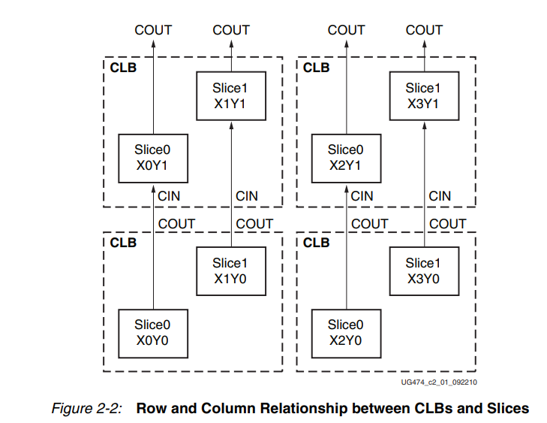
CLB Slices
A CLB element contains a pair of slices, and each slice is composed of four 6-input LUTs and eight storage elements.
These two slices do not have direct connections to each other, and each slice is organized as a column. Each slice in a column has an independent carry chain.
Reference: Figure2-2: Xilinx 7 Series FPGAs Configurable Logic Block User Guide (UG474), Page 17
https://www.xilinx.com/support/documentation/user_guides/ug474_7Series_CLB.pdf

Slide 4
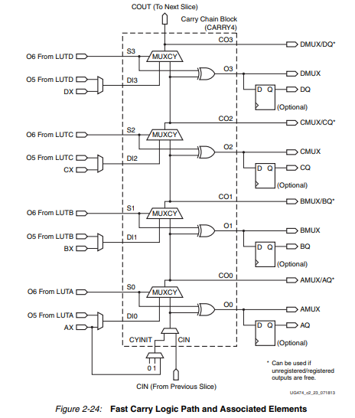
Carry4 Primitive
Diagram for Fast Carry Chain Logic
(Carry4)
Reference: Figure2-24: Xilinx 7 Series FPGAs Configurable Logic Block User Guide (UG474), Page 43
https://www.xilinx.com/support/documentation/user_guides/ug474_7Series_CLB.pdf

Slide 5
The carry4 primitive has the following pins-
Port | Direction | Width | Function
O | Output | 4 | Carry chain XOR general data out
CO | Output | 4 | Carry-out of each stage of the carry chain
DI | Input | 4 | Carry-MUX data input
S | Input | 4 | Carry-MUX select line
CYINIT | Input | 1 | Carry-in initialization input
CI | Input | 1 | Carry cascade input
29-09-2019
TIFR-FCRIT

Slide 6
Use Of Carry4 Primitive for our Delay Chaining (Limited to Creating Delay)
The carry4 primitive takes 2 types of carry inputs:
CYINIT:
The CYINIT line is used to initialize Carry bit for the first carry4 instance ONLY.
CI:
The further carry4 primitive instances will take carry input from the CI input pin.
The CI input pin is used because it is optimised to take input from cascading logic slices. The output of a slice (CO[3]) is connected to the CI pin.
Reference: Time-to-Digital Converter Using a Tuned-Delay Line Evaluated in 28-, 40-, and 45-nm FPGAs https://ieeexplore.ieee.org/document/7448918
29-09-2019
TIFR-FCRIT

Slide 7
Use Of Carry4 Primitive for our Delay Chaining (Continued..)
S:
S or the select input is used to select the input line for the multiplexer (MUXCY).
S values:
0: Select the D input of the corresponding bit.
1: Select the carry line from the previous.
The value of S input is always set to 1 for delay chaining as for each multiplexer in the carry4 primitive we are selecting the carry to be forwarded to the further logic elements.
DI:
The value of DI is not relevant because
We always use 1 as input to S pin so that the carry propagates.
The value of D is never selected in the multiplexers.
29-09-2019
TIFR-FCRIT

Slide 8
Use Of Carry4 Primitive for our Delay Chaining (Continued..)
Outputs:
CO:
The CO wire output consists of the output that is selected in the multiplexers.
For the delay chaining, the propagated value is the carry value that is propagated through the multiplexers.
The CO[3] is used as the cascading input for different slices.
O:
The output of the O wire is the XOR value of the Select line and the propagated carry value
Further explanation of the CO and O is done using the Post Implementation Timing Diagram
29-09-2019
TIFR-FCRIT

Slide 9
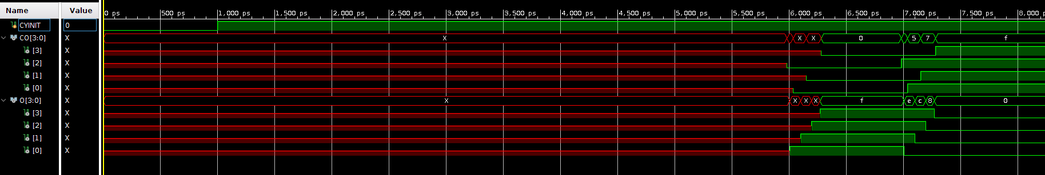
Correction to our code-
We realized that the output for all the carry4 primitives was undefined for a few picoseconds in the starting before becoming stable and properly defined.
Hence we decided to give our input signal after a delay of 40ns after begin.
29-09-2019
TIFR-FCRIT

Slide 10
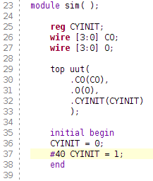
Updated simulation code-
29-09-2019
TIFR-FCRIT

Slide 11
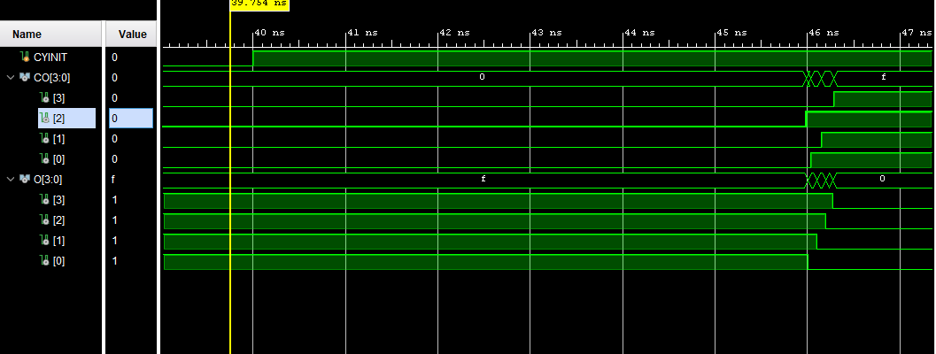
Post Implementation Timing Diagram
29-09-2019
TIFR-FCRIT

Slide 12
Understanding CO and O output using the Post Implementation timing Diagram
For The CO output:
We can see that the CO output is Changing from Logic value 0 to 1.
This is because the carry value of 1 is forwarded by the multiplexers which is then sent to the the CO output lines.
For the O output:
We can see that the Value of O changes from 1 to 0:
This is because:
Initially the XOR output of the select line (S[3:0]=1) and the propagation(0) is 1.
After the carry is propagated through each multiplexer then we see that the propagated value changes to 1 which on XOR with the Select line produces Output 0.
29-09-2019
TIFR-FCRIT

Slide 13
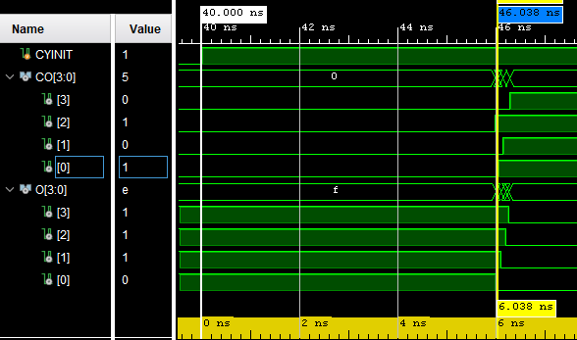
Measuring Timings:
Carry Input(CYINIT=1) and CO[0]=1

Slide 14
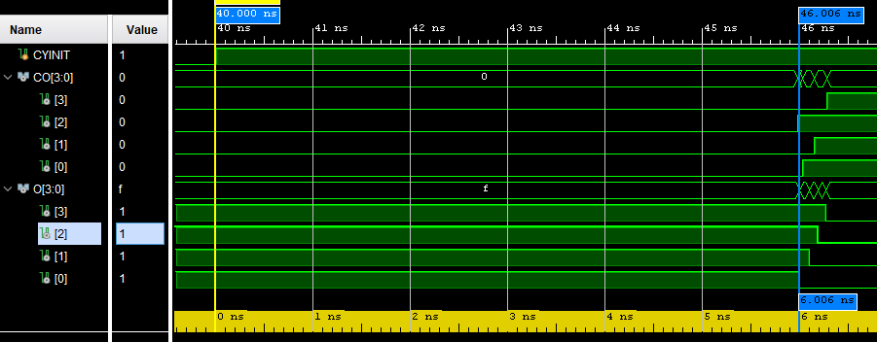
Measuring Timings:
Carry Input(CYINIT=1) and O[0]=0

Slide 15
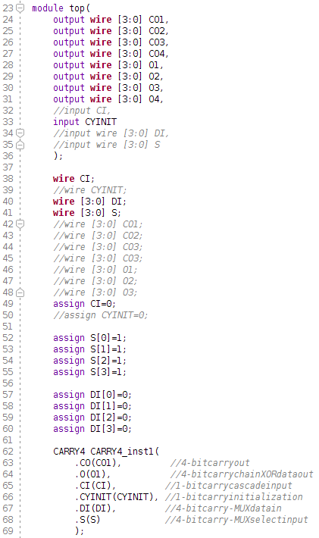
Code for tracking the output pins for all carry4 primitives-
29-09-2019
TIFR-FCRIT

Slide 16
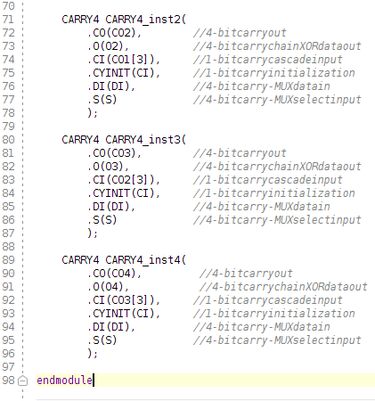
29-09-2019
TIFR-FCRIT

Slide 17
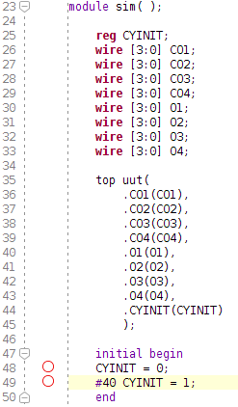
Simulation code for tracking the output pins for all carry4 primitives-
29-09-2019
TIFR-FCRIT

Slide 18
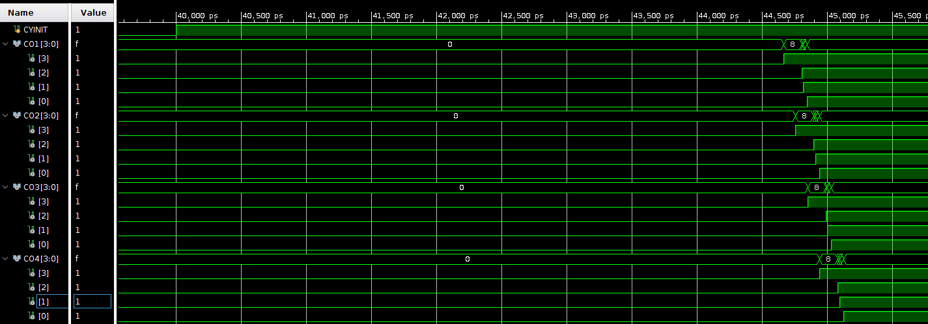
Post-synthesis simulation (CO pins)-
29-09-2019
TIFR-FCRIT

Slide 19
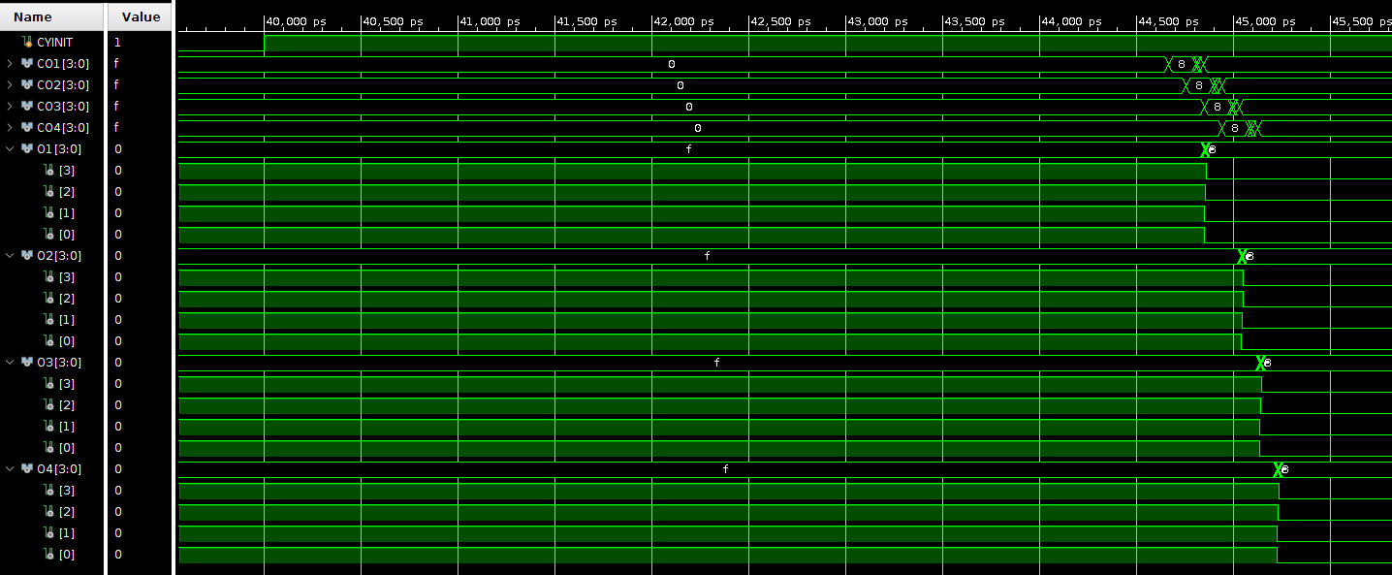
Post-synthesis simulation (O pins)-
29-09-2019
TIFR-FCRIT

Slide 20
Using generate-
We tried to cascade 10 carry4 primitives using the generate block.
The logic of cascading is similar to the one used before.
29-09-2019
TIFR-FCRIT

Slide 21
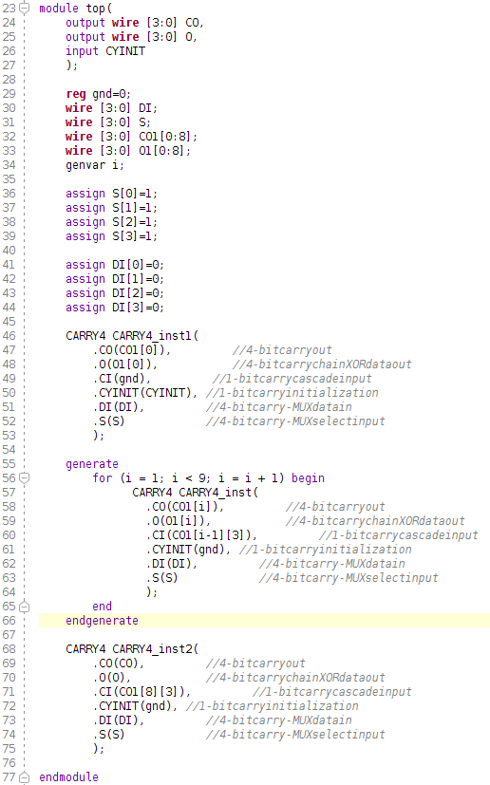
Code for generate-
29-09-2019
TIFR-FCRIT

Slide 22
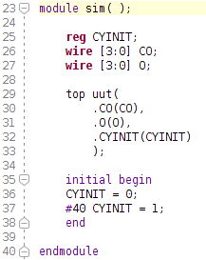
Simulation code for generate-
29-09-2019
TIFR-FCRIT

Slide 23
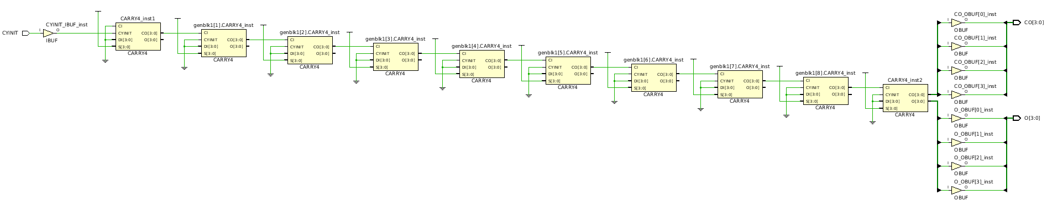
Schematic-
29-09-2019
TIFR-FCRIT

Slide 24
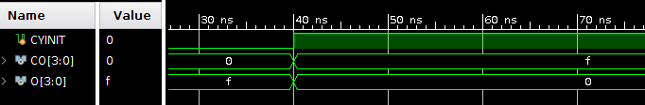
Behavioral simulation-
29-09-2019
TIFR-FCRIT

Slide 25
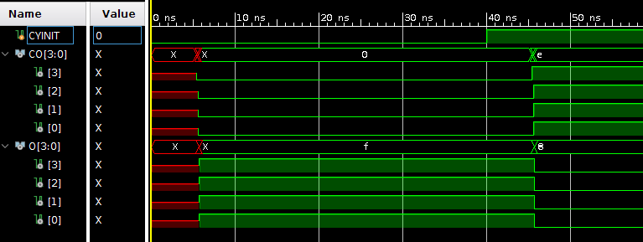
Post-synthesis timing simulation-
29-09-2019
TIFR-FCRIT

Slide 26
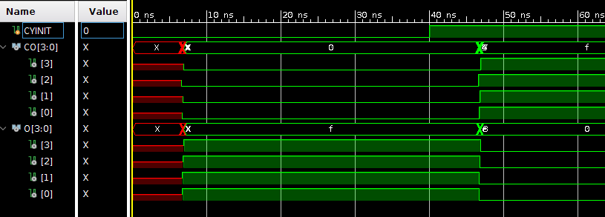
Post-implementation timing simulation-
29-09-2019
TIFR-FCRIT

Slide 27
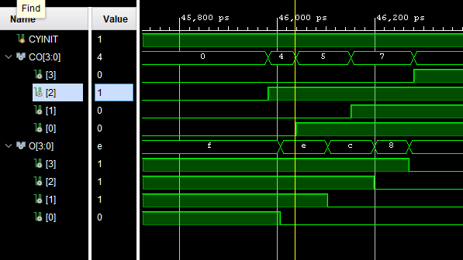
Doubts in Understanding:
Why does CO[2] produce output before the other CO values?
Is O pin output more reliable than CO output as there is proper step transition and it starts producing output before the CO[0] pin.
Fig:
Part of the Post-Implementation Timing Diagram as seen on slide 9

Slide 28
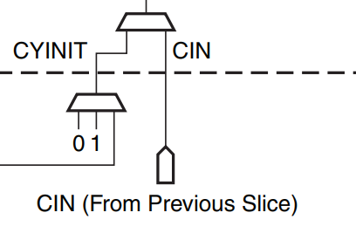
Doubts:
Need more clarity for the Carry Input Logic used?
Fig:
Part of the Logic Diagram as seen on slide 4
29-09-2019
TIFR-FCRIT

Slide 29
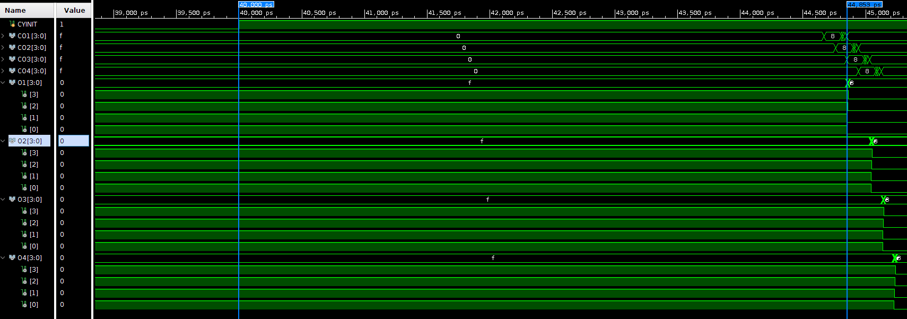
Doubts:
There is an initial delay of roughly 4ns before we are able to view the output on all pins.
29-09-2019
TIFR-FCRIT

